Slide 1
Farm Market Analysis Dashboard
Power BI Insights Report

Slide 2
Dashboard Overview
This dashboard provides insights into farm-level and market-level data.
It covers:
- Crop distribution and farmer participation
- Crop yield and profitability
- Seasonal price variations
- Market demand and fertilizer usage
These insights support farmers, advisors, and market researchers in decision-making.

Slide 3
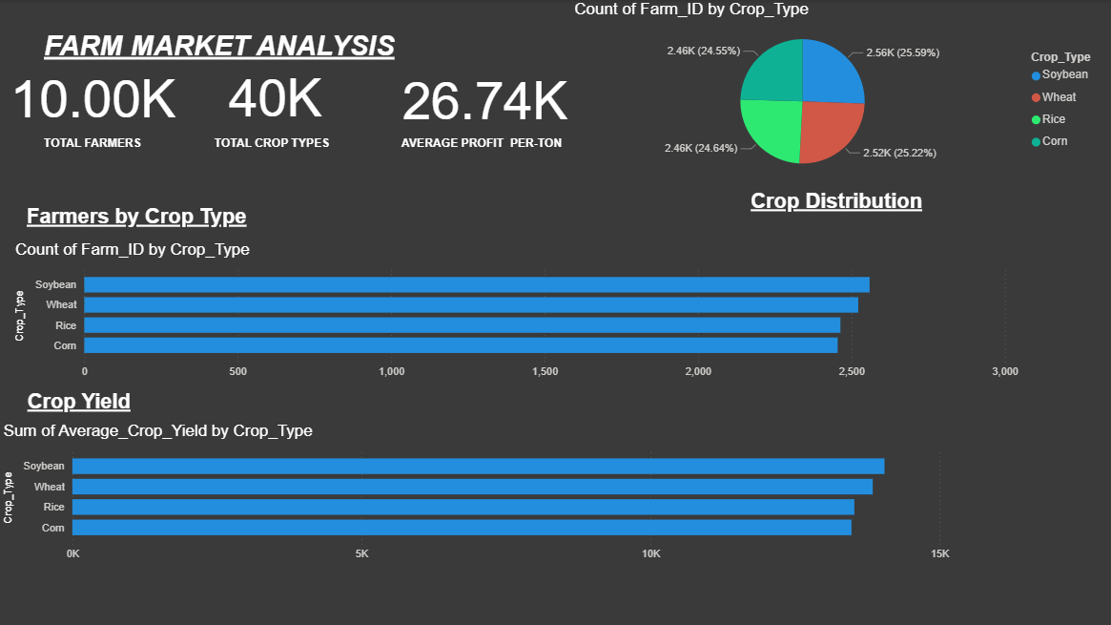
Farmers and Crop Distribution
This page shows crop distribution, farmer participation, and yield performance.

Slide 4
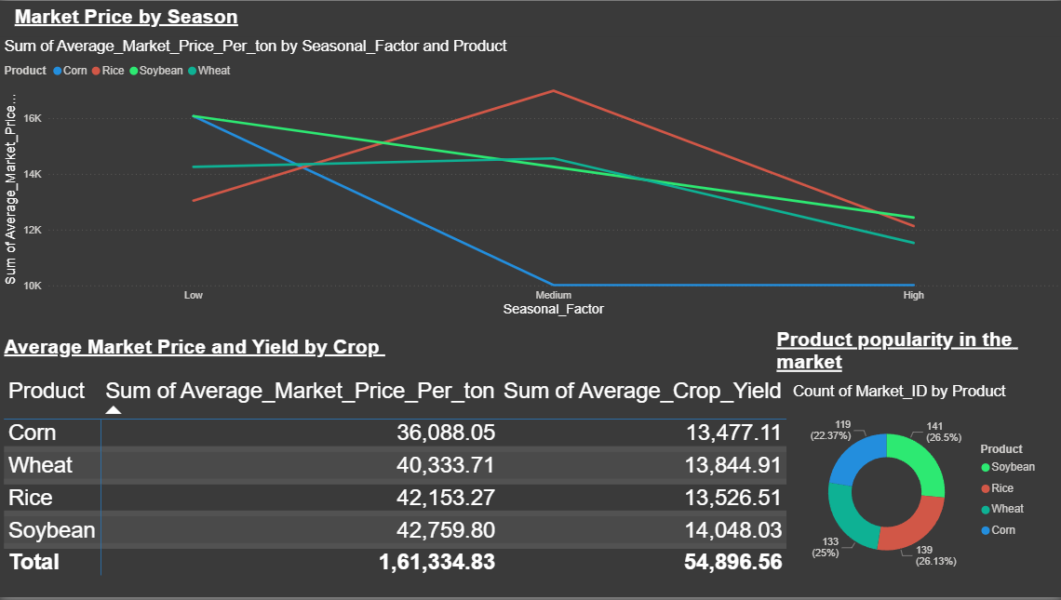
Market Prices and Seasonal Trends
This page analyzes market prices across seasons, yield comparisons, and product popularity.

Slide 5
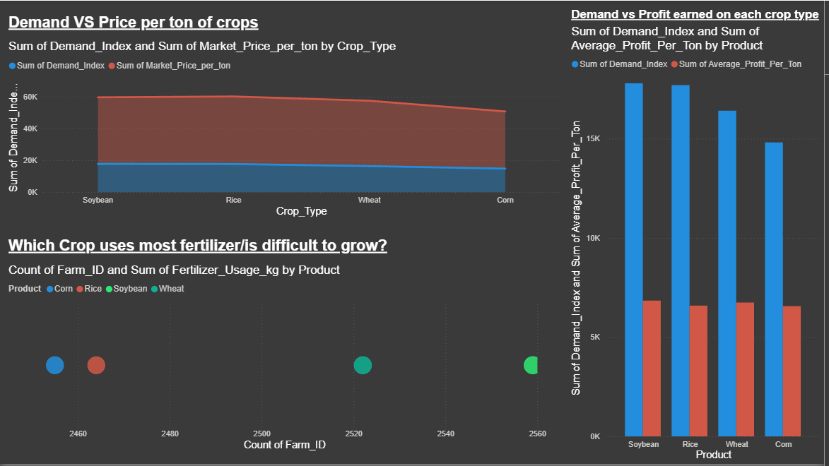
Demand, Profitability, and Fertilizer Usage
This page compares crop demand, profitability, and fertilizer usage to assess crop difficulty.

Slide 6
Conclusion and Insights
Key Insights:
- Soybean leads in yield and price.
- Corn lags in both demand and profit.
- Seasonal factors strongly affect pricing.
- Fertilizer usage shows cost trade-offs.
The dashboard guides data-driven decisions for farmers and market strategists.

